Slide 1
J&J Listerine Text Mining
Group 5
Hao Deng | Daniel Le | Kim-Cuong Nguyen | Florence Wang
August 24, 2020

Slide 2
Data Summary
Method-ology
Analysis Result
Conclusion
Recommend-ation
Executive Summary
AGENDA

Slide 3

Data Summary
Methodology
Analysis Result
Conclusion
Recommendation
Executive Summary
EXECUTIVE SUMMARY
Reviews from Listerine & vendor websites
Production mentions on social media
KEY FINDINGS & RECOMMENDATIONS
Findings:
Good flavors
Much positive sentiment overall
No obvious evidence of COVID-19 impact on product sales
Recommendations:
Cross reference with sales to validate the analysis
2018
2019
2020
Listerine & 20 competitor brands
Listerine Products
Competitors
Marketing Strategies are debatable
Cross Reference of Sales data is needed
People mention/hashtag Listerine over Internet but not helping on sales
Competitor brands seem not putting effort as much as Listerine in Public Relation
Top Product Feature Reviews
Positive Reviews
Negative Reviews
Good taste
Convenience
Clean and fresh feeling
Product unavailability
Strong flavor
White films left in mouth after use
Notes:
Start with an Executive Summary slide. This contains business question, findings (conclusion, any recommendation?) and modelling.
https://slideuplift.com/blog/how-to-ace-an-executive-summary/

Slide 4
Executive Summary
Methodology
Analysis Result
Conclusion
Recommendation
Data Summary
DATA SUMMARY
Category and Ratings need to be added to Brandwatch dataset before the two datasets can be combined.
 | BazarVoice | Brandwatch
Sources | reviews on Listerine website (listerine.com) | - social media posts that mention the products (Twitter, Tumbler, etc.) - reviews on other platforms (Amazon, Costco, etc.)
Brands | Listerine | Listerine & 20 competitors
Time Period | 01.2018 – 06.2020 | 01.2018 – 06.2020 for Listerine 01.2018 – 04.2020 for others
Dataset size | 8,591 | 241,339
Labelled by Category | Yes | No
Ratings Provided | Yes | No
Sample Review | Please bring it back! It's the only one I like. Finding a replacement will be difficult. | (Twitter) RT @RisasDental Is your oral health a part of your New Year's resolutions? Here's a list of the best foods for a healthy smile to start off the year. (Amazon) n n Terrible floss, falls apart too easily n n
Assign Category
Assign Sentiment
Data Cleaning

Slide 5
Executive Summary
Analysis Result
Conclusion
Recommendation
Methodology
Data Summary
METHODOLOGY
PREPROCESS DATA
Remove duplicates
Remove promotional contents
BUILD MODELS
Analyze sentiment of Brandwatch texts
Classify product category of Brandwatch texts
GENERATE INSIGHTS
Sentiment across Listerine categories
Sentiment across brands (Listerine vs. competitors)
Sentiment over product features
etc.
Analyze sentiment per product feature

Slide 6
Executive Summary
Analysis Result
Conclusion
Recommendation
Methodology
Data Summary
DATA CLEANING - Brandwatch
Lots of duplicates in the dataset cannot be removed simply using drop_duplicates function.
Sometimes when I watch the Redskins play football, I like to roll up a listerine strip …..
RT @chaddukes Sometimes when I watch the Redskins play football, I like to roll up a listerine strip …..
zuode: she gargled Â my balls likeÂ they were, Â listerine
zuode: she gargled Â my balls likeÂ they were, Â listerine ????
Original Data Size
241,000
Remove @, URLs, ‘RT’
Remove special characters
Remove leading & trailing spaces
142,000
Calculate pairwise cosine similarity
Use threshold = 0.9
….. The best way to ensure strong dental #health is to take care of your #smile and visit Dr. Barreto regularly: https://t.co/rBfUzvLHlO https://t.co/uKRsyAGc9r
….. The best way to ensure strong dental #health is to take care of your #smile and visit our #dentist regularly: https://t.co/1gmYaBwEeP https://t.co/5LVAMtmr1g
132,000
Final Data Size

Slide 7
Executive Summary
Analysis Result
Conclusion
Recommendation
Methodology
Data Summary
MODELLING - SENTIMENT
Apply Vader to assign sentiment to Brandwatch texts – negative, neutral, and positive
Manually check accuracy of 300 random texts, 100 texts for each predicted class
Concerning BazarVoice dataset, a review with ratings 4-5 is assigned with Positive, 3 – Neutral, 1-2 - Negative
 |  | PREDICTED CLASS
TRUE CLASS |  | Negative | Neutral | Positive
 | Negative | 88 | 8 | 4
 | Neutral | 10 | 84 | 6
 | Positive | 3 | 11 | 86
Accuracy:
86%
(a review is categorized as positive if it has a rating of 3 and above)

Slide 8
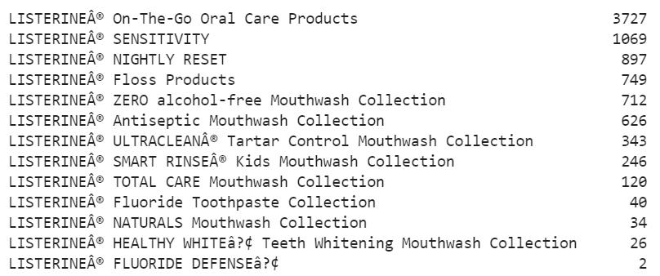
Executive Summary
Analysis Result
Conclusion
Recommendation
Methodology
Data Summary
MODELLING - CATEGORY
Apply multiclass classification with word embeddings to assign product category for Listerine texts in Brandwatch
Build model using BazarVoice dataset as train and test set by 70-30
Predict for 9/13 categories

Slide 9
Executive Summary
Analysis Result
Conclusion
Recommendation
Methodology
Data Summary
Appendix 1 provides comparison on performance between train and test data.
MODELLING - CATEGORY
Confusion Matrix on test data:
Predict most correctly on Floss Products, On-The-Go Oral Care Products, SENSITIVITY
Misclassify mostly among Mouthwash Products
 |  | PREDICTED CLASS
 |  | Antiseptic Mouthwash | Floss Products | NIGHTLY RESET | On-The-Go Oral Care | SENSIT-IVITY | SMART RINSEÂ® Kids Mouthwash | TOTAL CARE Mouthwash | ULTRACLEANÂ® Tartar Control Mouthwash | ZERO alcohol-free Mouthwash
TRUE CLASS | Antiseptic Mouthwash | 116 | 14 | 21 | 21 | 4 | 5 | 0 | 12 | 2
 | Floss Products | 4 | 210 | 1 | 7 | 3 | 1 | 0 | 0 | 1
 | NIGHTLY RESET | 14 | 4 | 194 | 22 | 17 | 3 | 1 | 17 | 6
 | On-The-Go Oral Care | 7 | 9 | 23 | 1049 | 7 | 4 | 1 | 2 | 3
 | SENSITIVITY | 11 | 2 | 37 | 9 | 234 | 6 | 1 | 10 | 9
 | SMART RINSEÂ® Kids Mouthwash | 1 | 1 | 3 | 4 | 0 | 68 | 0 | 3 | 2
 | TOTAL CARE Mouthwash | 6 | 2 | 3 | 2 | 4 | 3 | 2 | 1 | 5
 | ULTRACLEANÂ® Tartar Control Mouthwash | 10 | 2 | 17 | 13 | 3 | 2 | 0 | 52 | 5
 | ZERO alcohol-free Mouthwash | 12 | 6 | 17 | 9 | 3 | 5 | 5 | 24 | 128
Accuracy of train-test:
87.6% vs 80.6%

Slide 10
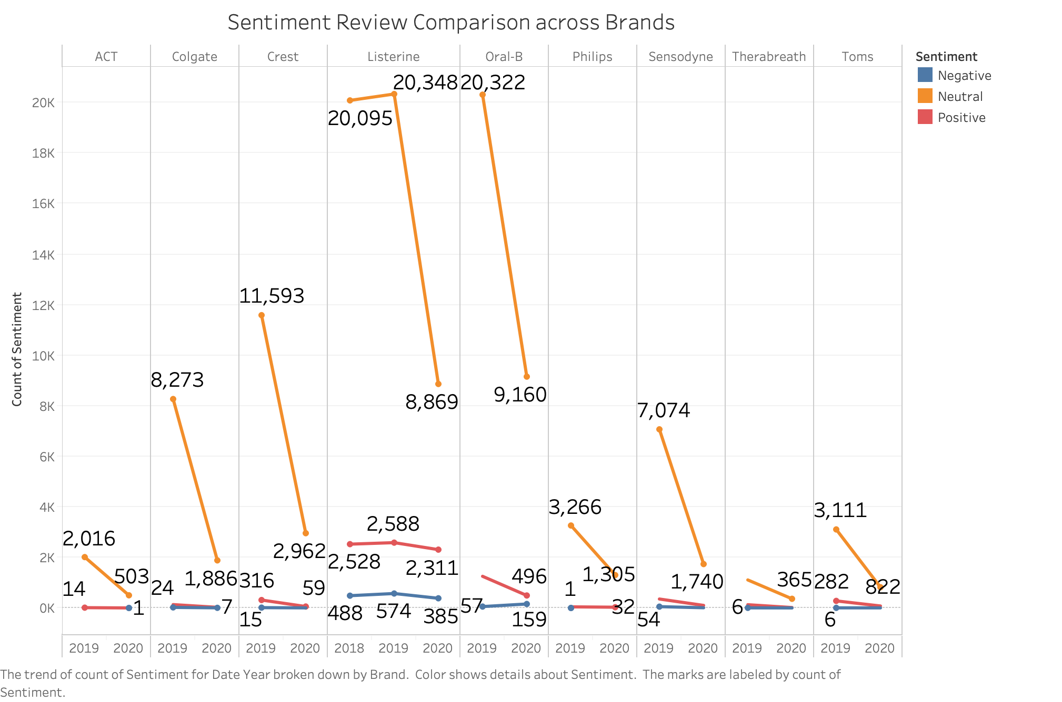
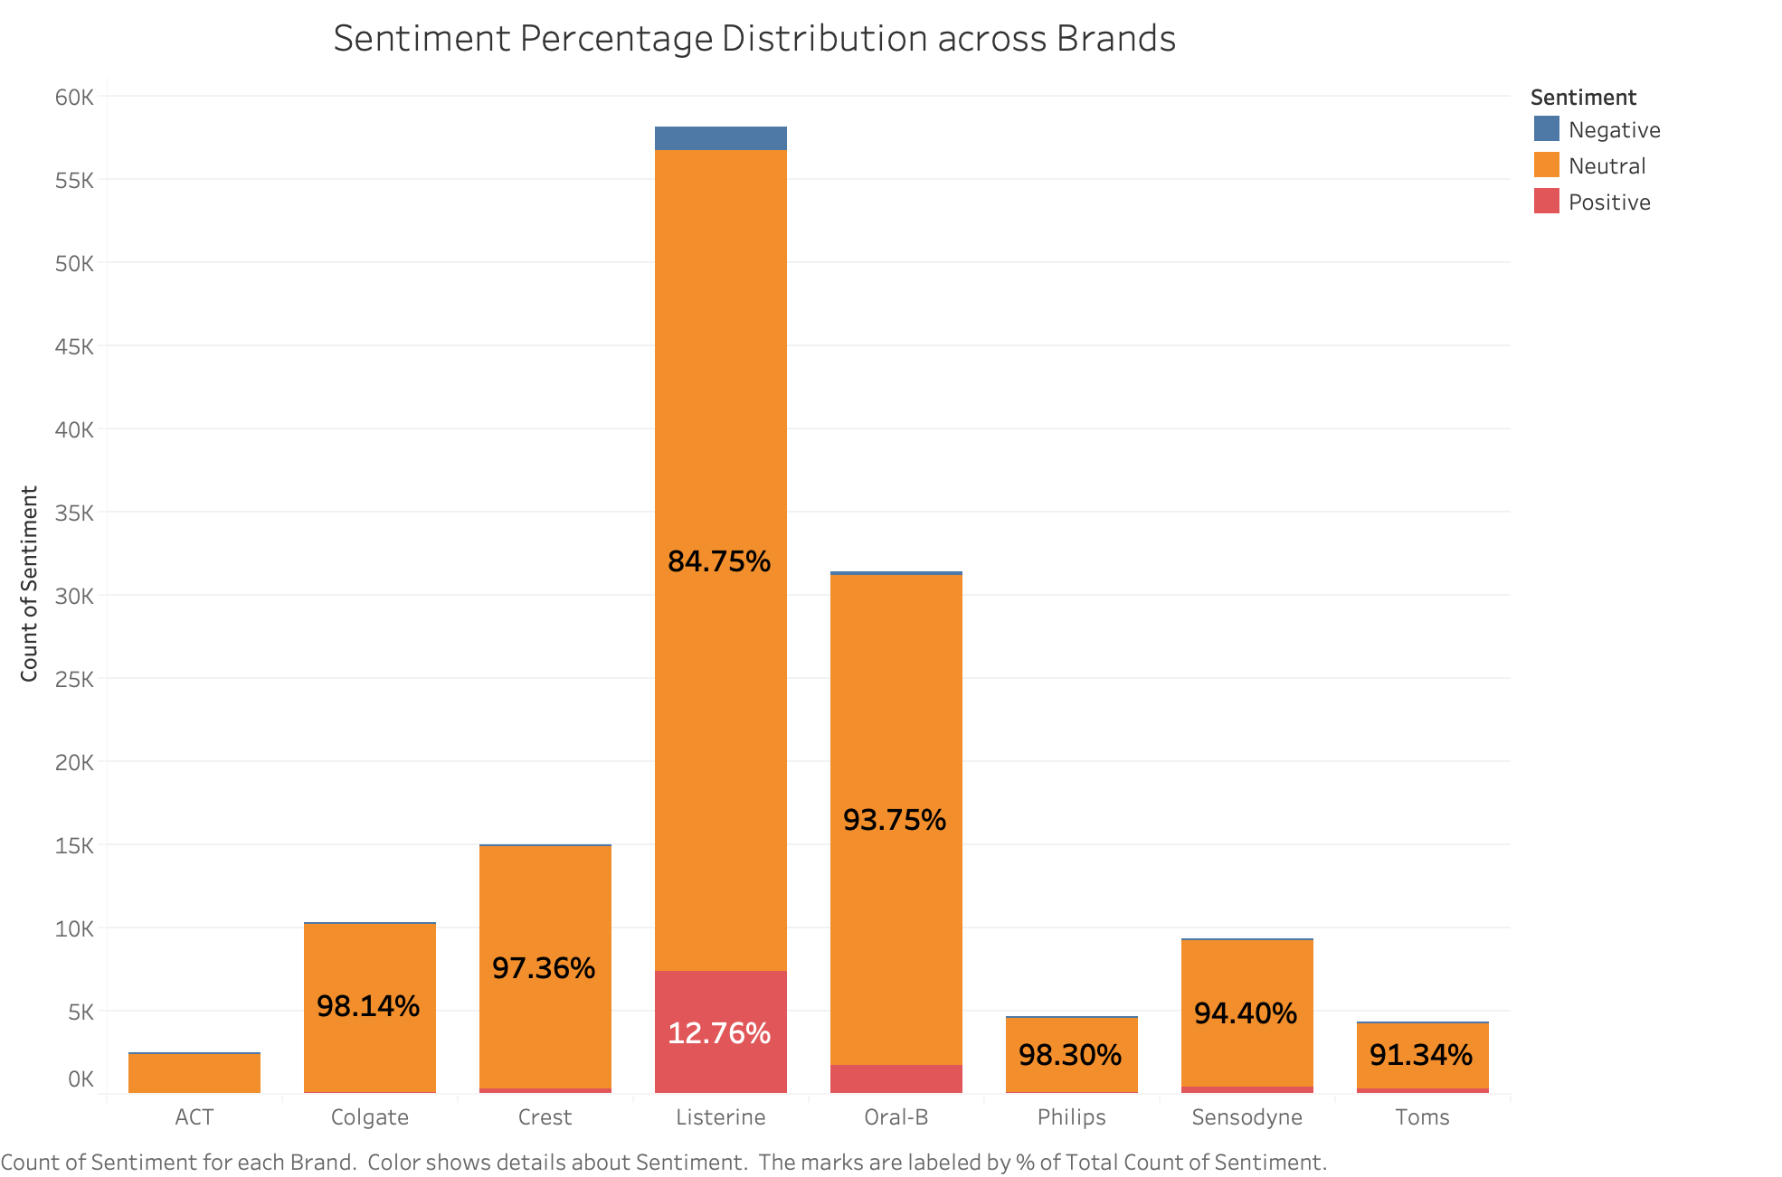
Executive Summary
Conclusion
Recommendation
Data Summary
Methodology
Analysis Result
ANALYSIS RESULT
Is Listerine doing a good job?

Slide 11
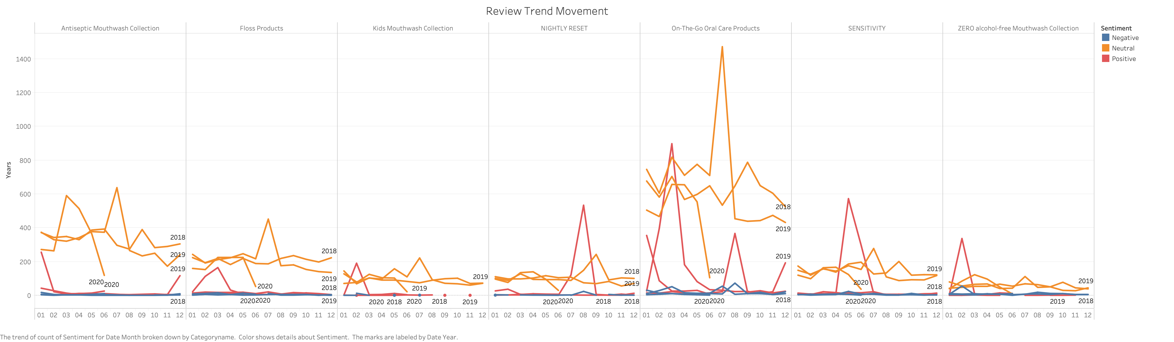
Executive Summary
Conclusion
Recommendation
Data Summary
Methodology
Analysis Result
ANALYSIS RESULT
Why reviews surged around that time? What pushed to surge?
Seasonal Peaks?

Slide 12
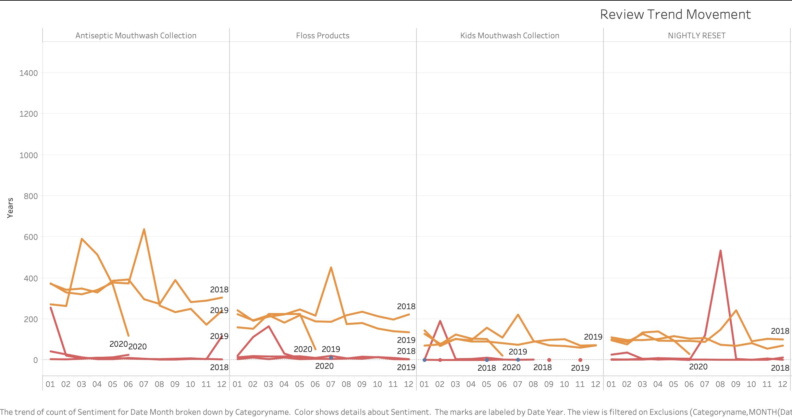
Executive Summary
Conclusion
Recommendation
Data Summary
Methodology
Analysis Result
Secret Disclosure
Sanitizing mouth COVID-19
Pride Weekend
Demand of Discontinued Product
Sponsor Post
Funny Video

Slide 13
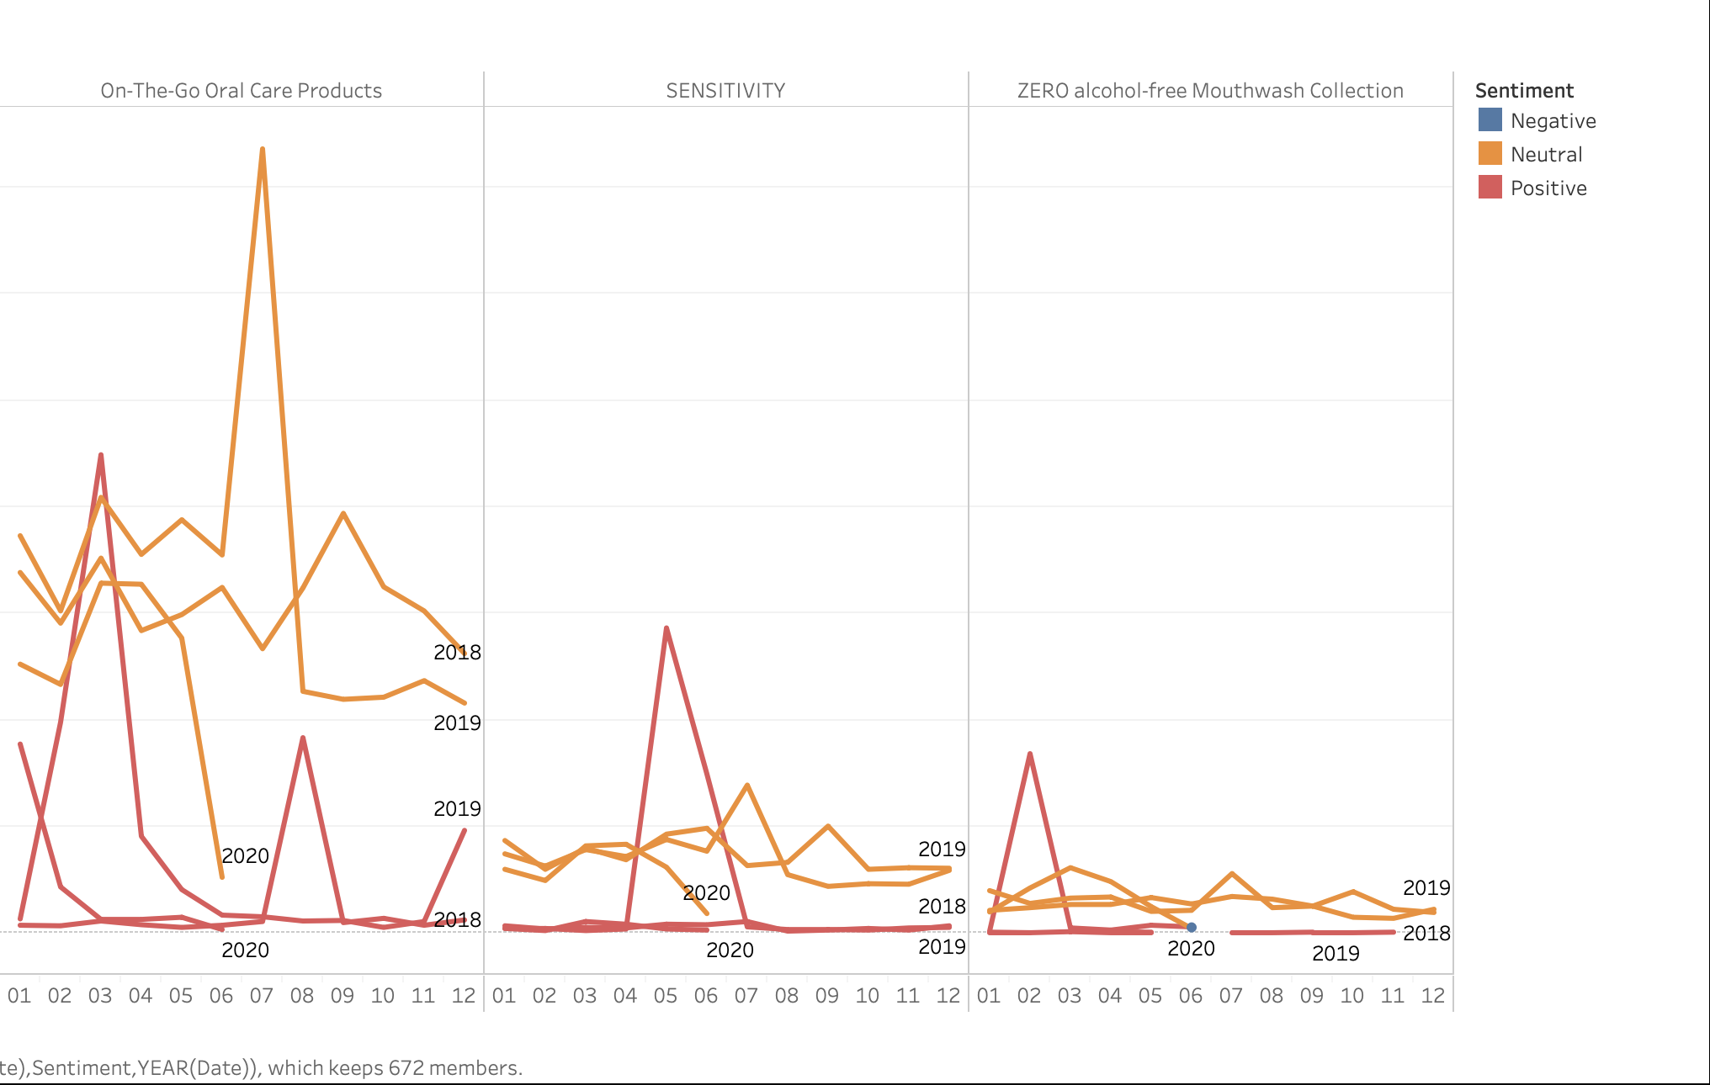
Executive Summary
Conclusion
Recommendation
Data Summary
Methodology
Analysis Result
Secret Disclosure - 2
Pride Weekend – Rainbow Packaging
What happened to all Positive Sentiment Surge???​
An embarrassing video posted

Slide 14
Executive Summary
Conclusion
Recommendation
Data Summary
Methodology
Analysis Result
PRODUCT FEATURES - LDA
Apply LDA model to find out most discussed features with positive sentiment of Listerine products
Features | Interpretation
Clean & Fresh | Clean and fresh feeling after use
Product Taste | Favorable taste | No burning feeling | No alcohol
Mint Flavor | Great mint flavor | Fresh breath | Readiness right after use
Chewable/ Swallowable | Convenience for use anywhere
Store and Bring | Travel size | Easy to bring along
Gum Care | Good for gum | Good protection for teeth and gum
Easy to use | Convenience from design | Easy-to-use strips
Popularity

Slide 15
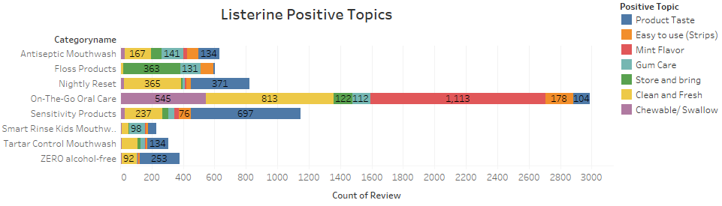
Executive Summary
Conclusion
Recommendation
Data Summary
Methodology
Analysis Result
PRODUCT FEATURES - LDA
On the go products – Mint flavor is the product selling point.
Chewable/ Swallowable features for on-the-go products are vital.
Floss products are favored mostly because of its portable product design.

Slide 16
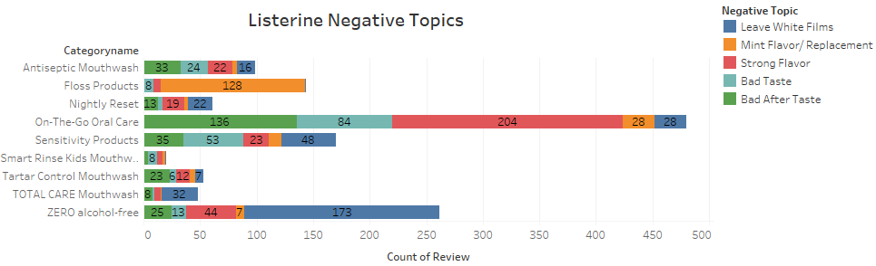
Executive Summary
Conclusion
Recommendation
Data Summary
Methodology
Analysis Result
PRODUCT FEATURES - LDA
Many product categories, especially Zero alcohol-free are reported to leave white films inside mouth after use.
On-the-go products: Some customers feel mint flavor strong, while cinnamon is horrible taste.
Floss Products: Mint flavor is not welcomed, but the unflavored replacement head is discontinued.

Slide 17
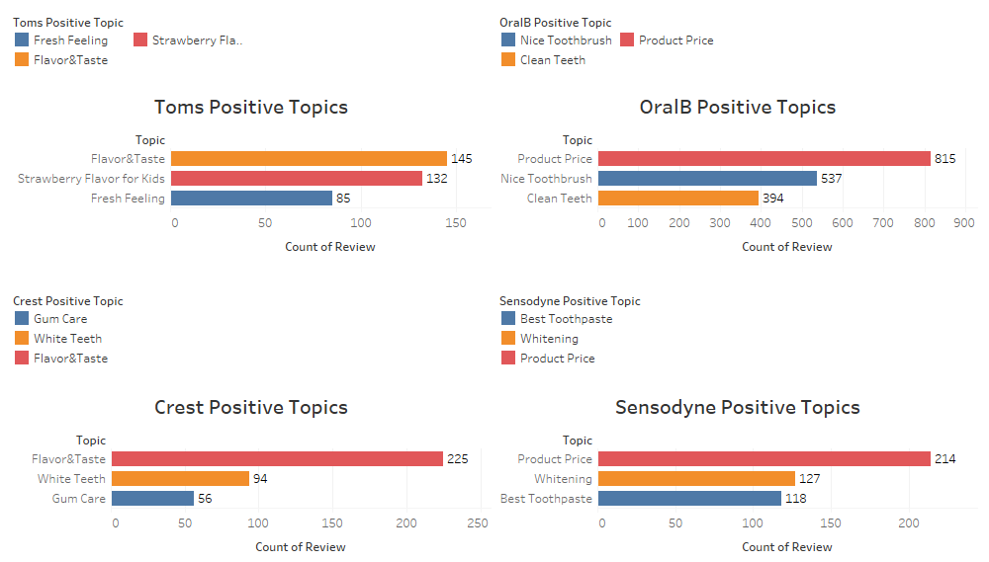
Executive Summary
Conclusion
Recommendation
Data Summary
Methodology
Analysis Result
PRODUCT FEATURES - LDA
Product for kids: natural ingredients and flavor are decisive points for parents.
Oral-B mostly focus on toothbrush.
Product Price is one of the most important factor that gain good impression for other brands.
Customers choose other brands because of well-known whitening features.

Slide 18
Executive Summary
Recommendation
Data Summary
Methodology
Conclusion
Analysis Result
CONCLUSION
From Sentiment Analysis
From Product Feature Analysis
Continue of Free Full-Size Sample marketing strategy is DEBATABLE
Sentiment Data Trend DID NOT 100% indicate the product sales is increased after marketing promotion
Promote seasonal/limited packaging IS NOT attracting clients for positive reviews
NO obvious evidence of COVID-19 is hurting/helping sales of all products
Strong mint flavor is controversial among customers
Replaceable and unflavored floss are more popular among customers
Customers do mind the white films left after using alcohol-free mouthwash
After-taste feeling affects customer's attitude on products
Travel size / portable products become a new trend

Slide 19
Executive Summary
Data Summary
Methodology
Analysis Result
Recommendation
Conclusion
RECOMMENDATION
Cross reference of sales records is needed to prove the success of marketing strategy
Stop free sample give out strategy before proving it is viable
Separate & Group the review text sources for a better text-preprocessing & sentiment analysis
Bundle sale classic flavor with the flavors which are not satisfied by customers, such as cinnamon flavor

Slide 20
Executive Summary
Data Summary
Methodology
Analysis Result
Conclusion
Recommendation
LIMITATIONS
Limited amount of data on product feature analysis. Risk of several important features being not covered.
Most of Brandwatch dataset texts are assigned with neutral.
Total positive and negative reviews used are over 12,000 over 3 selected years.
2. Brandwatch dataset category prediction limitation
Cannot manually check accuracy of category prediction on Brandwatch data because it’s not easy to understand which category the texts refer to.

Slide 21
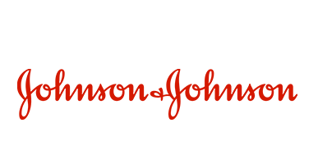
Thank you!

Slide 22
Executive Summary
Data Summary
Methodology
Analysis Result
Conclusion
Recommendation
APPENDIX 1
Multiclass classification for product category - Confusion Matrix on train data
 |  | PREDICTED CLASS
 |  | Antiseptic Mouthwash | Floss Products | NIGHTLY RESET | On-The-Go Oral Care | SENSIT-IVITY | SMART RINSEÂ® Kids Mouthwash | TOTAL CARE Mouthwash | ULTRACLEANÂ® Tartar Control Mouthwash | ZERO alcohol-free Mouthwash
TRUE CLASS | Antiseptic Mouthwash | 325 | 9 | 38 | 17 | 15 | 1 | 0 | 23 | 3
 | Floss Products | 2 | 516 | 0 | 4 | 0 | 0 | 0 | 0 | 0
 | NIGHTLY RESET | 13 | 0 | 516 | 14 | 20 | 2 | 2 | 37 | 15
 | On-The-Go Oral Care | 6 | 4 | 18 | 2578 | 5 | 6 | 0 | 3 | 2
 | SENSITIVITY | 13 | 2 | 62 | 22 | 609 | 7 | 1 | 30 | 4
 | SMART RINSEÂ® Kids Mouthwash | 0 | 1 | 7 | 4 | 4 | 135 | 0 | 7 | 6
 | TOTAL CARE Mouthwash | 28 | 8 | 4 | 4 | 6 | 1 | 28 | 3 | 10
 | ULTRACLEANÂ® Tartar Control Mouthwash | 16 | 4 | 55 | 8 | 11 | 8 | 0 | 129 | 8
 | ZERO alcohol-free Mouthwash | 10 | 3 | 40 | 12 | 11 | 8 | 9 | 43 | 367
Accuracy: 87.6%

Slide 23
Executive Summary
Data Summary
Methodology
Analysis Result
Conclusion
Recommendation
APPENDIX 2
Multiclass classification for product category - Confusion Matrix on test data
 |  | PREDICTED CLASS
 |  | Antiseptic Mouthwash | Floss Products | NIGHTLY RESET | On-The-Go Oral Care | SENSIT-IVITY | SMART RINSEÂ® Kids Mouthwash | TOTAL CARE Mouthwash | ULTRACLEANÂ® Tartar Control Mouthwash | ZERO alcohol-free Mouthwash
TRUE CLASS | Antiseptic Mouthwash | 116 | 14 | 21 | 21 | 4 | 5 | 0 | 12 | 2
 | Floss Products | 4 | 210 | 1 | 7 | 3 | 1 | 0 | 0 | 1
 | NIGHTLY RESET | 14 | 4 | 194 | 22 | 17 | 3 | 1 | 17 | 6
 | On-The-Go Oral Care | 7 | 9 | 23 | 1049 | 7 | 4 | 1 | 2 | 3
 | SENSITIVITY | 11 | 2 | 37 | 9 | 234 | 6 | 1 | 10 | 9
 | SMART RINSEÂ® Kids Mouthwash | 1 | 1 | 3 | 4 | 0 | 68 | 0 | 3 | 2
 | TOTAL CARE Mouthwash | 6 | 2 | 3 | 2 | 4 | 3 | 2 | 1 | 5
 | ULTRACLEANÂ® Tartar Control Mouthwash | 10 | 2 | 17 | 13 | 3 | 2 | 0 | 52 | 5
 | ZERO alcohol-free Mouthwash | 12 | 6 | 17 | 9 | 3 | 5 | 5 | 24 | 128
Accuracy: 80.6%

